Slide 1
Overview of Scrum-agile
Notes:
Good afternoon everyone, my name is Mike. My team was recently selected to pilot a shift to the Scrum-agile approach to software development with the SNHU Travel project. Today I will be explaining the structure of a Scrum-agile team, how the development lifecycle works in an agile approach, how our traditional waterfall approach would have affected the project, and what factors to consider when choosing between a waterfall and agile approach to software development.

Slide 2

Roles on a Scrum-agile Team
Product Owner
Responsible for managing the product backlog.
Scrum Master
Ensures the team is using scrum effectively. Also responsible for removing obstacles that block the team’s progress.
Team Member
Responsible for creating a product based off the backlog items.
May specialize in different tasks, but all team members share the title of developer.
(Cobb, 2015)
Notes:
First up is the structure of a Scrum-agile team. There are three major roles on this team. First is the product owner, who is responsible for managing the product backlog that contains the feature requests, or user stories for the product. This includes gathering information from stakeholders, creating the user stories with that information, prioritizing the stories based on their importance, and making sure that the stories are clear enough for the team to implement them. Second is the scrum master, who guides the team through the scrum process to ensure that it is effective. They also remove obstacles that block the team’s progress, which may include discouraging interactions from outside the team that are unhelpful, or improving the environment the team works in. This role is focused on ensuring the team can function at a high level. The last role is the team member. Although a team member may specialize in a particular task, all team members have the title of developer. The team members are expected to work together to create a functional product using the stories from the product backlog. This structure encourages equality and collaboration.

Slide 3
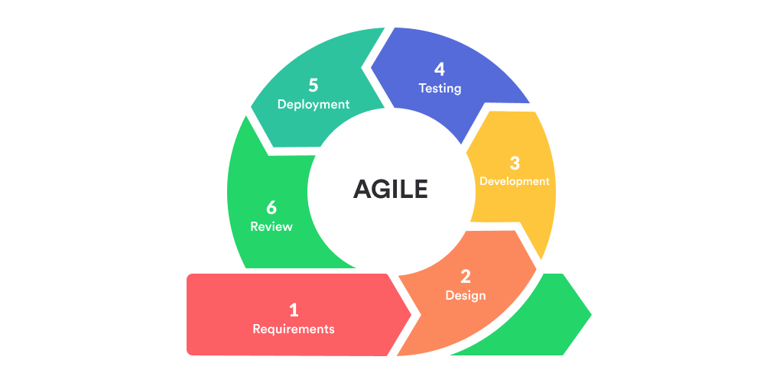
Software Development Lifecycle Phases in Agile
Figure 1. Agile Lifecycle. Retrieved from https://mlsdev.com/blog/agile-sdlc
Notes:
When using agile, the software development lifecycle, or SDLC, is performed in several short iterations to rapidly develop a working product. The first phase is gathering information about features and changes that should be worked into the product during the iteration. In the second phase, the design of these features and how they will fit in to the finished product by the end of the iteration is decided. In the third phase, the features are developed and connected to the product. In the fourth phase, testing is done to ensure each feature is functioning properly, and that the whole product is functional with these added features. In the fifth phase, the product is in its final state for this iteration and could be deployed. There may be iterations where the product is not publicly deployed for various reasons, but this phase still allows for gathering of feedback. In the sixth phase, the team reviews the iteration and discusses what went well and what could have been improved. After the sixth phase, another iteration is started to improve the product more.

Slide 4
Differences With a Waterfall Approach
More planning time
Unable to adjust for new information
SDLC – Waterfall Model (n.d.)
Notes:
When using a waterfall approach, each phase of development can only begin after the previous phase is completed. This also implies that changes cannot be made to phases that have been completed. During this project, this would have greatly affected a couple areas. First, the project and its requirements were very rough initially, which is acceptable when using an agile approach since they can be defined as necessary. However, the requirements would have to be defined before any other work was completed if a waterfall approach was used, which would have delayed the development of the project and potentially caused it to not be in a deliverable state by the deadline. Second, the client introduced a significant requirements change near the project deadline, which was only possible due to the iterative nature of the agile approach. My team was able to reprioritize their work to implement the change during the next iteration and still deliver a functional product. In a waterfall approach, it would have been far too late into development to introduce new requirements, which would have led to an unsatisfied client.

Slide 5
Choosing an Approach
Factors to consider include:
How well defined the requirements are
Availability of client and end-user feedback
The size of the project
Notes:
I mentioned earlier that the agile approach was well suited to the SNHU Travel project due to the roughly defined requirements, and it would work well with similar projects. However, if a project had known requirements that were unlikely to change, then a waterfall approach could be a better choice. The agile approach also relies on feedback to improve the iterations, so if the development team is unable to get a steady stream of feedback after each iteration, then it would be difficult to improve upon the product. If there was only a large batch of initial information to base the project off, then I would be more likely to choose a waterfall approach. The size of the project is also an important consideration. If it is a small enough project to be completed within the timespan of a single iteration, then a waterfall approach would be more efficient. A larger project that may need to adjust its use case during development would be a better choice for an agile approach.

Slide 6
References
Cobb, C. G. (2015). The project manager’s guide to mastering agile: Principles and practices for an adaptive approach. Wiley.
SDLC – Waterfall model. (n.d.). tutorialspoint. Retrieved April 18, 2021, from https://www.tutorialspoint.com/sdlc/sdlc_waterfall_model.htm

